Slide 1
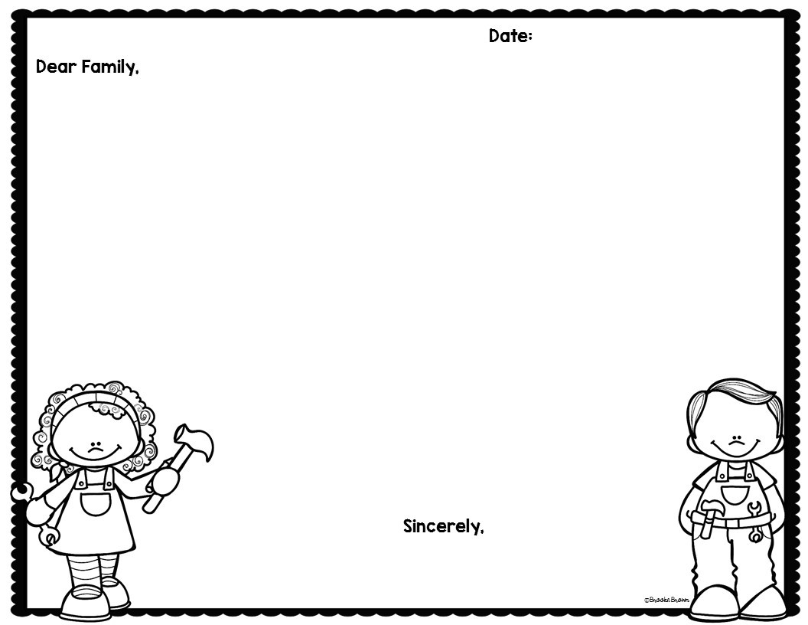
10/30/17 (Monday)
11/3/17 (Friday)
DUE:
Recently in 3rd grade our students have been working with forces. We have identified balanced and unbalanced forces. We have also worked with balloons in order to see the effect of charged particles on objects. More recently we have been working with magnets. Through our exploration we found that magnets can repel, attract, or have no interaction with other objects.
I would like for your child to discuss with you when a magnet may repel, attract, or have no interaction. Then as a family try to answer our challenge question!
Challenge Question:
Two magnets are placed on a table. One magnet is moved closer to the other. Using pictures and words, describe what will happen
Online Resources available:
HTTP://DJSCI.WEEBLY.COM
Mr. Shanbarger
AShanbarger@CCBOE.COM

