Slide 1
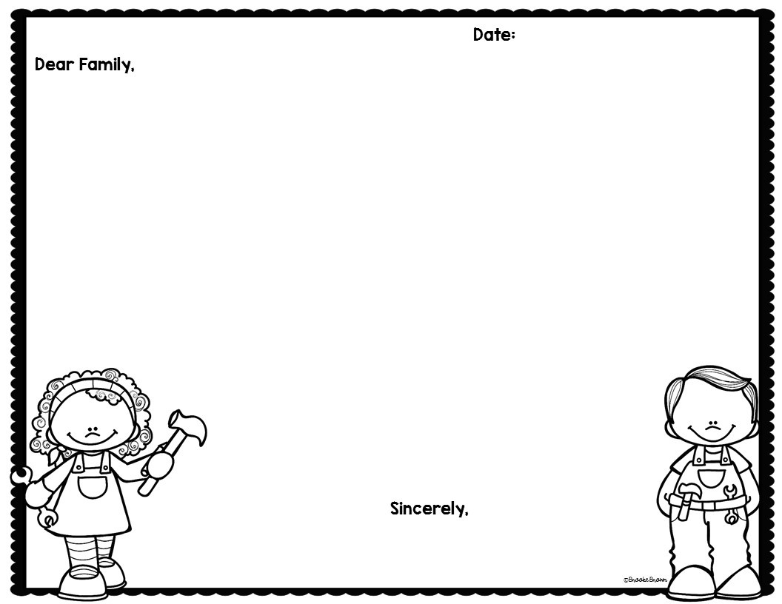
10/30/17 (Monday)
11/3/17 (Friday)
DUE:
Recently in 4th grade our students have been working with energy. We have identified what energy is and how it is transferred. We focused on the transfer of thermal or heat energy, sound, and electrical energy. We have also focused on the difference between potential and kinetic energy.
I would like for your child to discuss with you how they have noticed energy being transferred. They should include one example from class, and another example from their own life. Then as a family try to answer our challenge question!
Challenge Question:
Look at the circuit below. When it is used the light bulb does not light. Why isn’t it working? What could you change to make it work?
Online Resources available:
HTTP://DJSCI.WEEBLY.COM
Mr. Shanbarger
AShanbarger@CCBOE.COM

